Slide 1


Spring 2021
SKKU Biostats and Big data
CHOONG-WAN WOO | COCOAN lab | http://cocoanlab.github.io

Slide 2
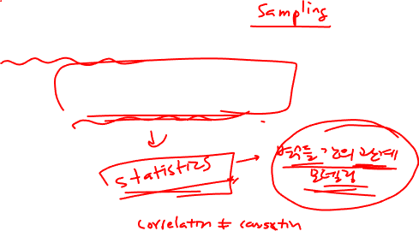
GBME Probability and Statistics
Lecture 09
Lecture 09
Designing experiments!
CHOONG-WAN WOO | COCOAN lab | http://cocoanlab.github.io

Slide 3
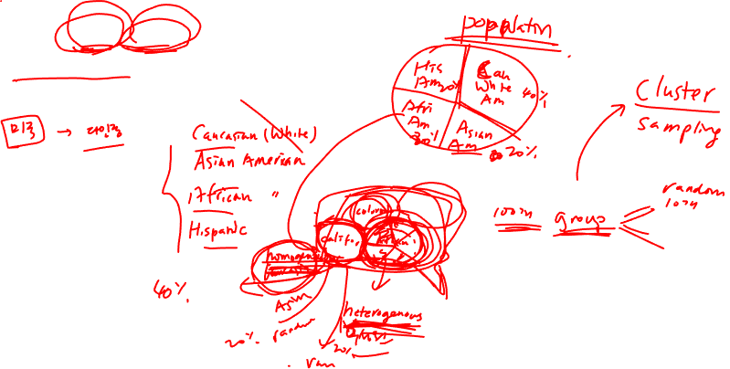
Lecture 09
Some questions from students
샘플링에서 cluster랑 stratified랑 명확하게 구분이 안돼서요ㅠㅠ 혹시 다른 예시로 설명해주실 수 있을까요...??
CHOONG-WAN WOO | COCOAN lab | http://cocoanlab.github.io

Slide 4
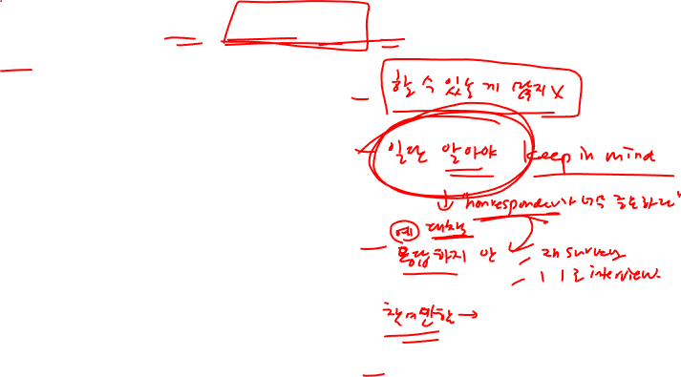
Lecture 09
Some questions from students
샘플링 시 실수할 수 있는 사항들에서 반응을 하지 않는 경우도 무시하지 말아야 한다고 하셨는데, 그런 경우는 그럼 어떻게 처리를 해야하는 건가요??
CHOONG-WAN WOO | COCOAN lab | http://cocoanlab.github.io

Slide 5
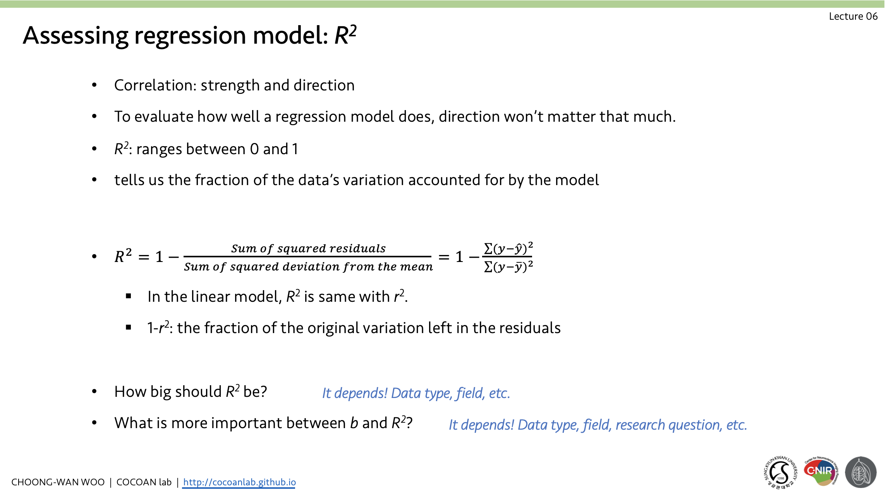
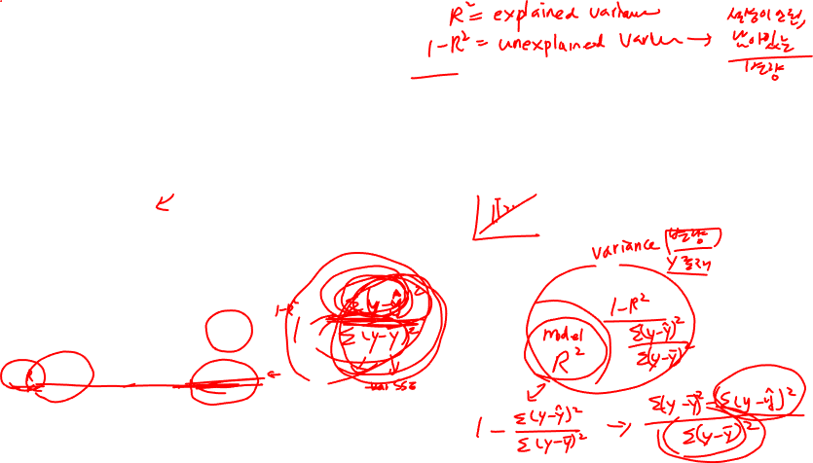
Lecture 09
Some questions from students
복습을 하는 동안, R square value 파트에서 궁금한 것이 있어서 메시지 드리게 되었습니다. R square value 파트의 슬라이드를 보면 1-r^2 : The fraction of the original variation left in the residuals 라는 내용이 있는데, 교수님께서 수업 시간에서 언급을 안 하고 넘어가셨지만, 해당 내용의 의미에 대해서 이해가 안 되었습니다.따라서, 다음 수업시간에서 교수님께서 1-r^2의 의미에 대해서 설명해주시면 R square 의 의미에 대해 더 이해가 쉬울 것 같습니다!
CHOONG-WAN WOO | COCOAN lab | http://cocoanlab.github.io

Slide 6
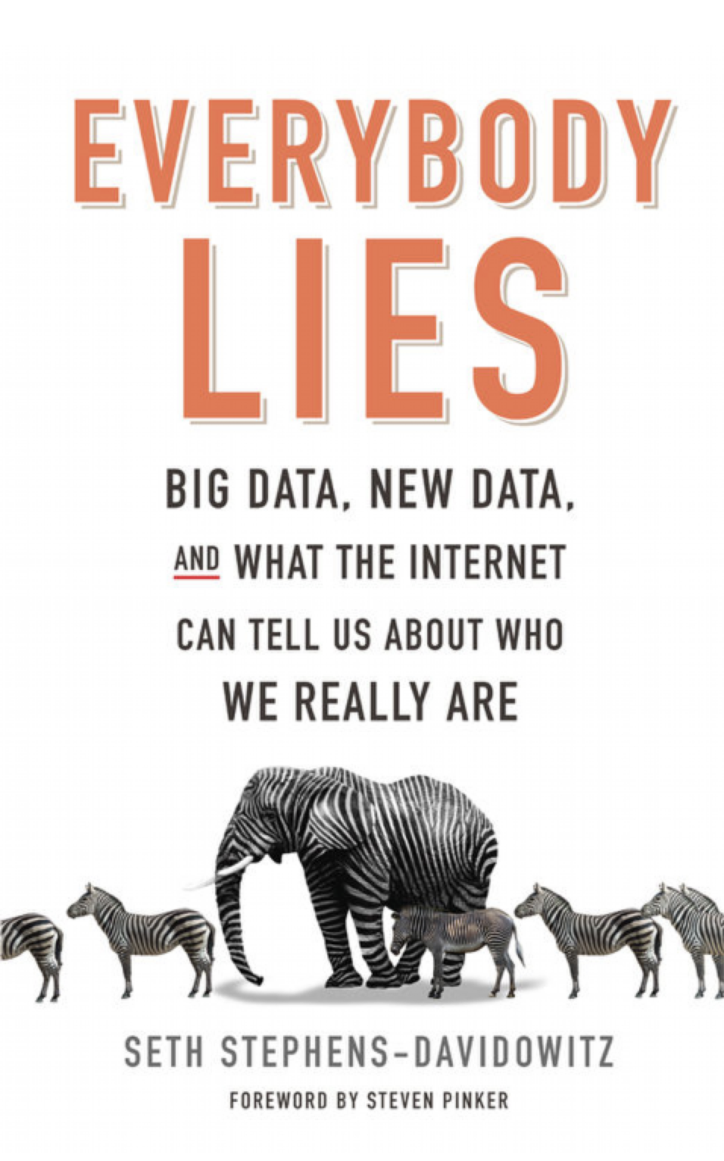
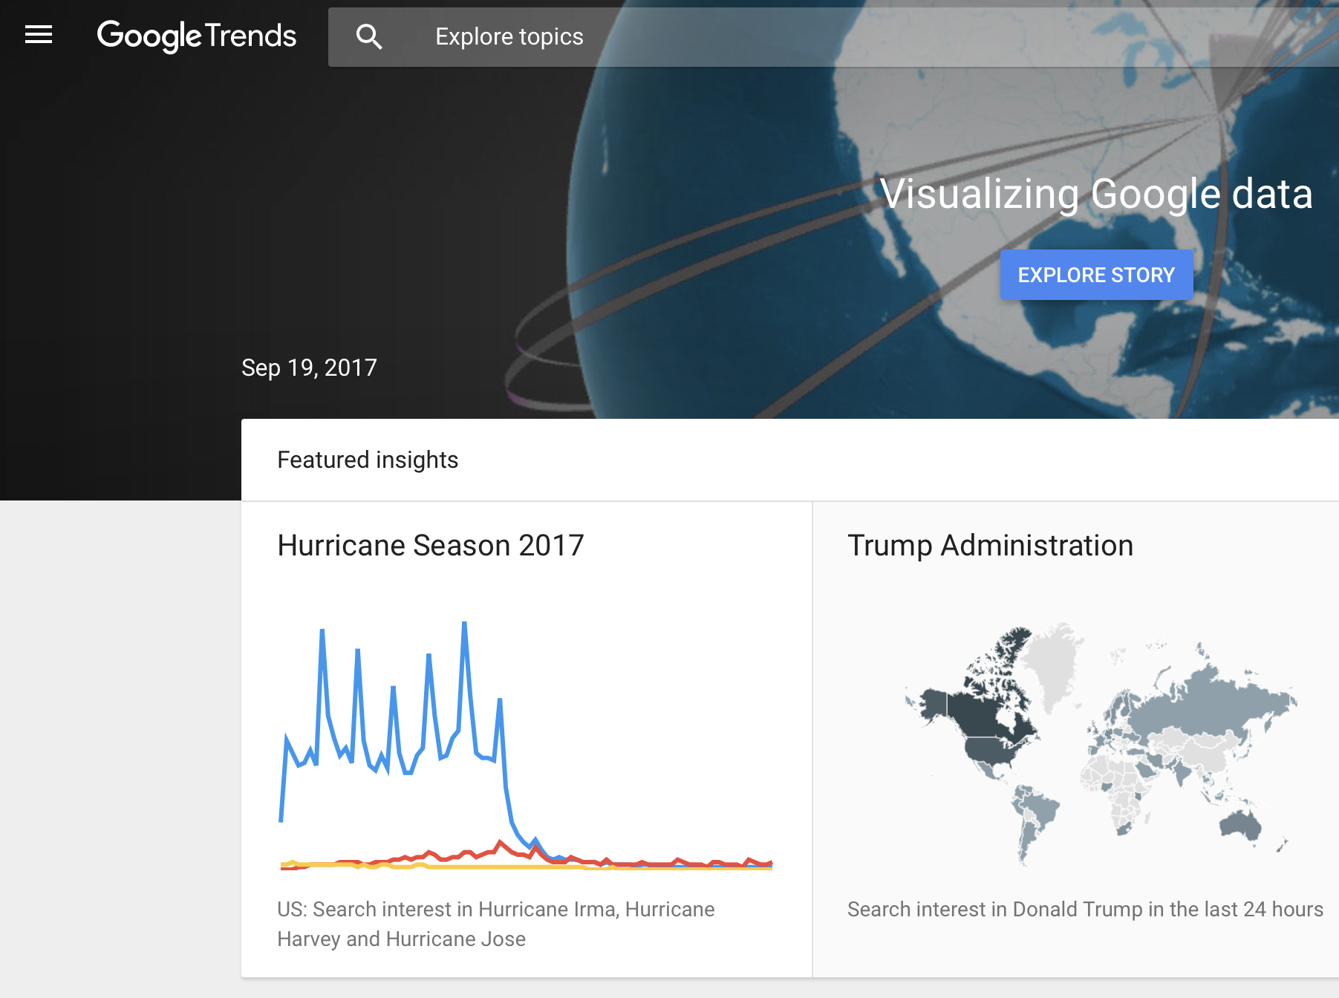
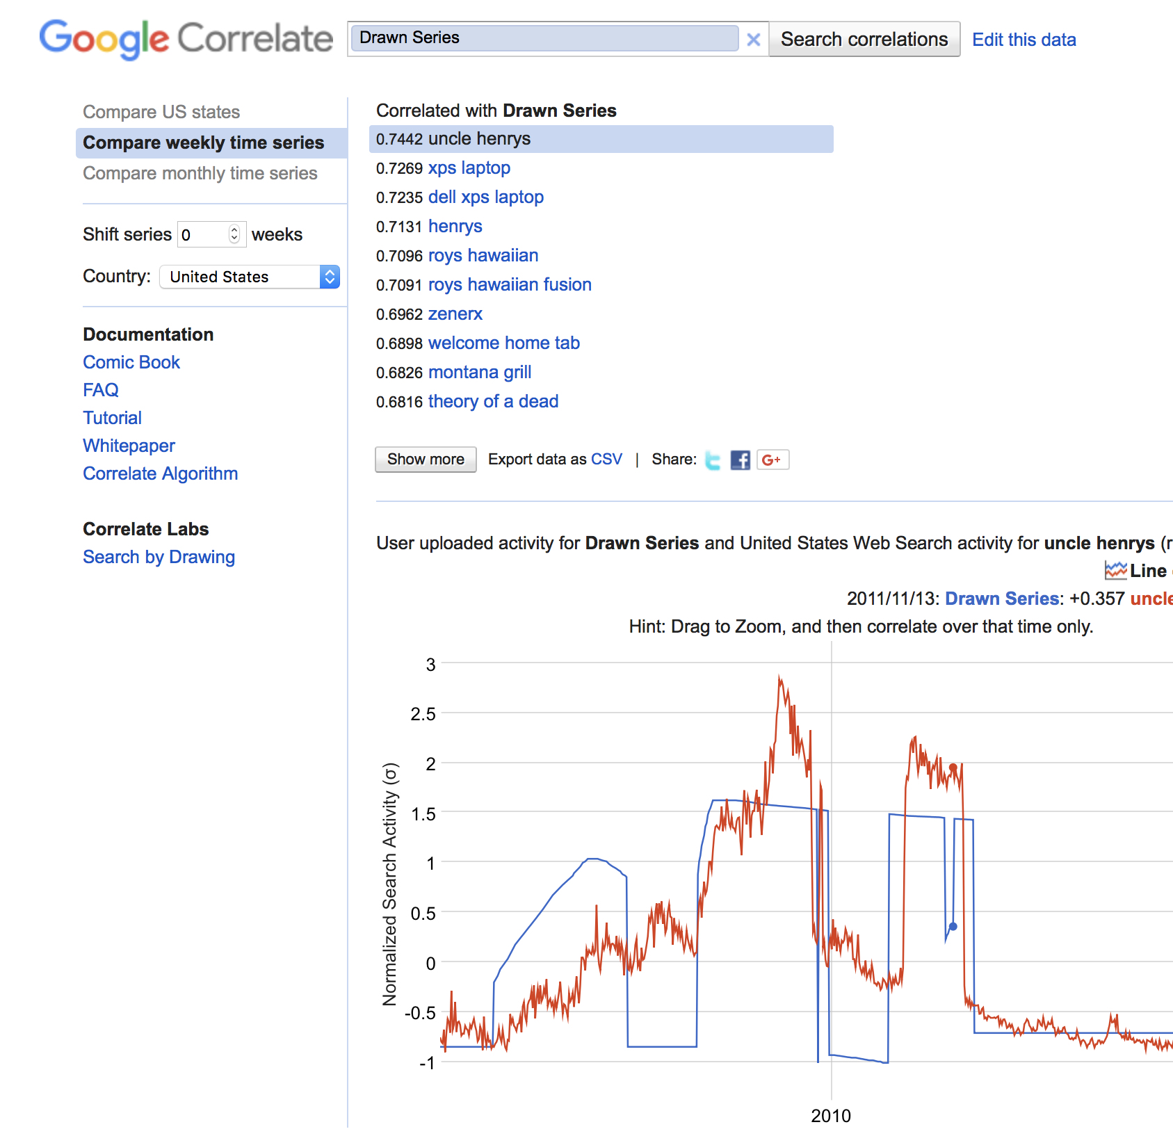
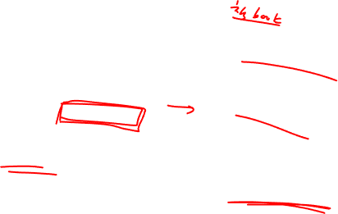
Lecture 09
Observational Studies
Researchers do not assign choices, they simply observe them.
An extreme case: https://www.google.com/trends/correlate/draw?p=us (not working)
Also Google trends: https://trends.google.com/trends/
CHOONG-WAN WOO | COCOAN lab | http://cocoanlab.github.io

Slide 7
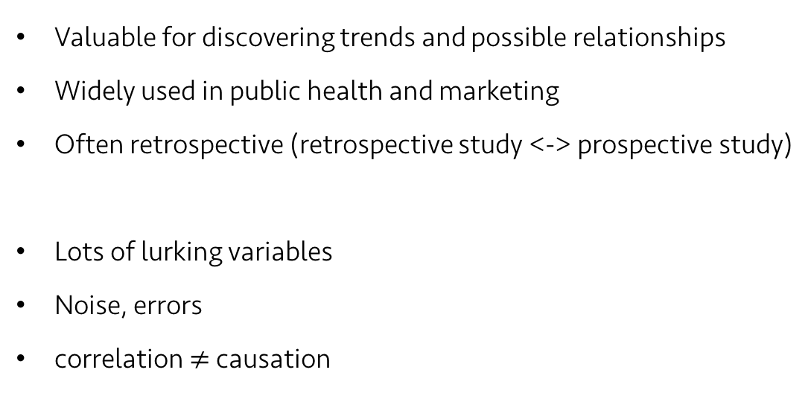
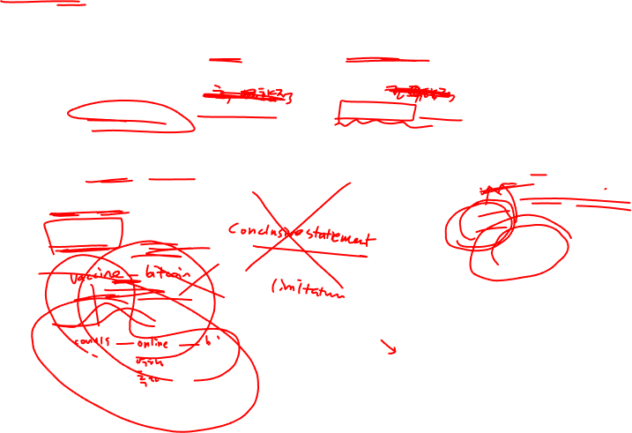
Lecture 09
Observational Studies
Valuable for discovering trends and possible relationships
Widely used in public health and marketing
Often retrospective (retrospective study <-> prospective study)
Lots of lurking variables
Noise, errors
correlation $≠$ causation
https://twitter.com/tomfishburne/status/455486271339511808
CHOONG-WAN WOO | COCOAN lab | http://cocoanlab.github.io

Slide 8
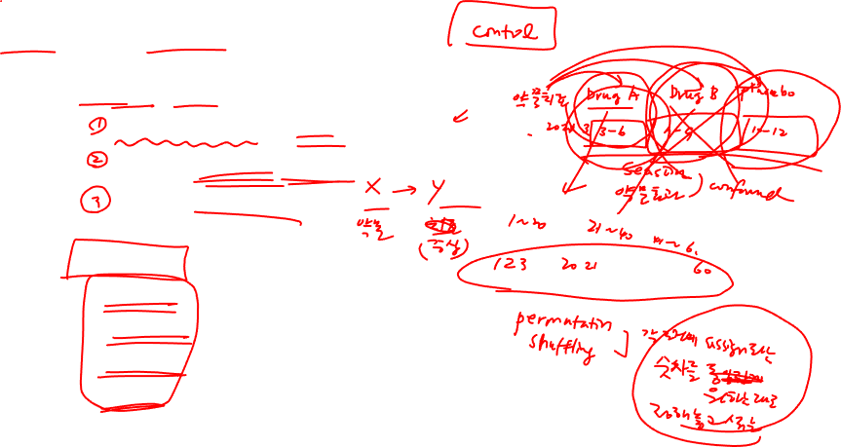
Lecture 09
Randomized, Comparative Experiments
Experiments require:
Random assignment of subjects to treatments
Manipulate explanatory variables (or factors)
Measure response variables
Four principles of experimental design
Control
Randomize
Replicate
Block
CHOONG-WAN WOO | COCOAN lab | http://cocoanlab.github.io

Slide 9
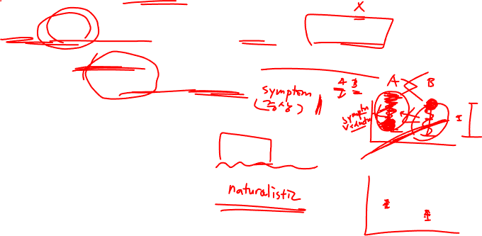
Lecture 09
Experimental design: Control
Control sources of variation other than the factors we’re manipulating
Making conditions as similar as possible for all treatment groups
To reduce the variability of the responses
Bad for generalizability?
Consideration: generalizability and ecological validity
CHOONG-WAN WOO | COCOAN lab | http://cocoanlab.github.io

Slide 10
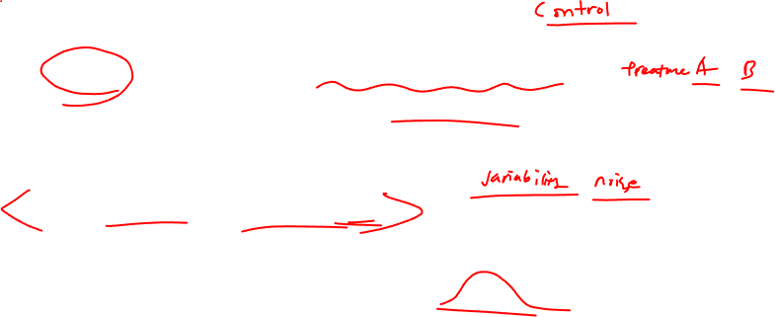
Lecture 09
Experimental design: Randomize
To equalize the effects of unknown or uncontrollable sources of variation
Not eliminating the effects of these sources, but distributing them equally across treatment levels
Protect against factors we might be missing
“Control what you can, and randomize the rest”
CHOONG-WAN WOO | COCOAN lab | http://cocoanlab.github.io

Slide 11
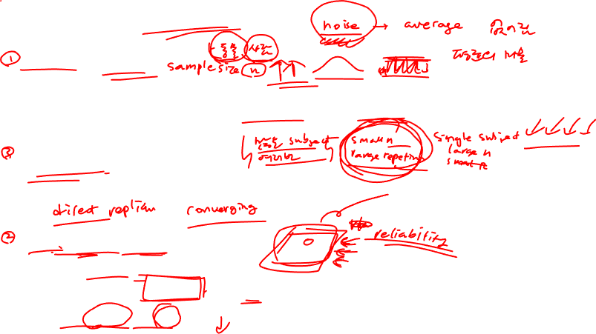
Lecture 09
Experimental design: Replicate
Subject-level replication
Repeat treatments to many subjects
The outcome of an experiment on a single subject is an anecdote (not data)
Study-level replication
The entire experiment is repeated on a different population of experimental units.
Within-subject level replication
Repeated measures
Can measure the reliability of a measure
Increase signal-to-noise ratio
CHOONG-WAN WOO | COCOAN lab | http://cocoanlab.github.io

Slide 12
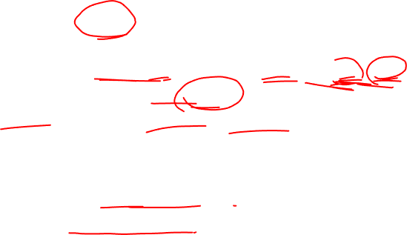
Lecture 09
Experimental design: Block
There are things that we are not studying, but we can’t control (e.g., male, female).
We can group similar individuals together (block), and randomize within each of these blocks.
This is a compromise between randomization and control, and this is not required, different than other three, Control, Randomize, Replicate.
This is an idea similar to stratified random sampling.
This design is called “Randomized block design”
CHOONG-WAN WOO | COCOAN lab | http://cocoanlab.github.io

Slide 13
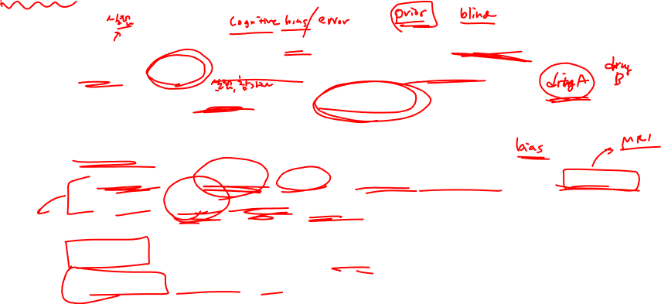
Lecture 09
Blinding
Humans are susceptible to errors in judgement (e.g., preference in cola tasting)
Blinding the participants to the treatment could prevent potential biases.
Experimenters can subconsciously provide contextual cues related to treatment.
Two classes of individuals who can affect the outcome of the experiment:
Those who could influence the results (e.g., subjects, treatment administrators, technicians, etc.)
Those who evaluate the results (e.g., judges, treating physicians, etc.)
Single-blind: either one of these classes are blinded
Double-blind: both classes are blinded
CHOONG-WAN WOO | COCOAN lab | http://cocoanlab.github.io

Slide 14
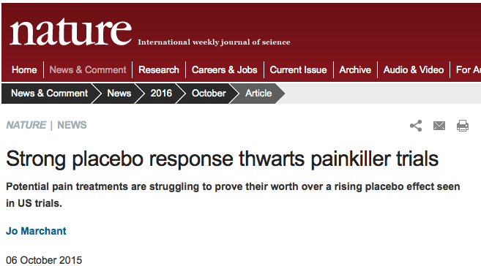
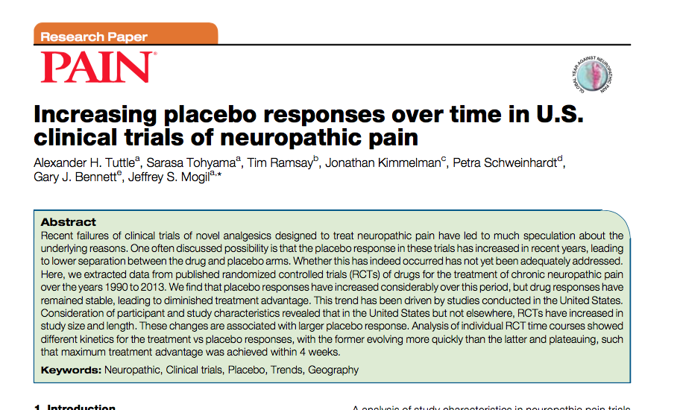
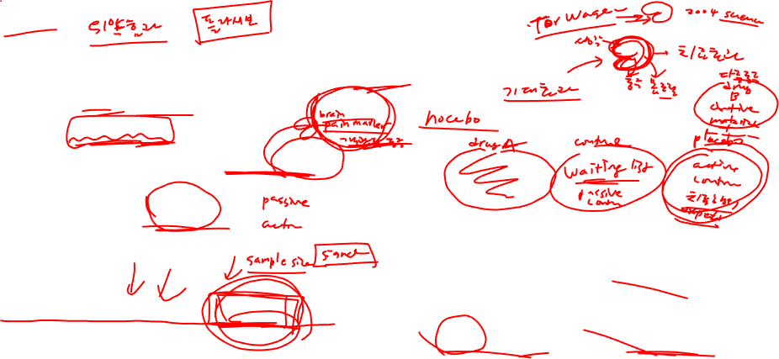
Lecture 09
Placebos
Simply applying any treatment can cause an improvement.
Placebo: “fake” treatment that looks just like the real treatment
Placebo effects tells us
The importance of effective blinding
The importance of comparing treatments with a proper control (e.g., active control)
CHOONG-WAN WOO | COCOAN lab | http://cocoanlab.github.io

Slide 15
Lecture 09
Quiz 09-1
https://forms.gle/tTtXG3XZXzWVAp176
CHOONG-WAN WOO | COCOAN lab | http://cocoanlab.github.io

Slide 16
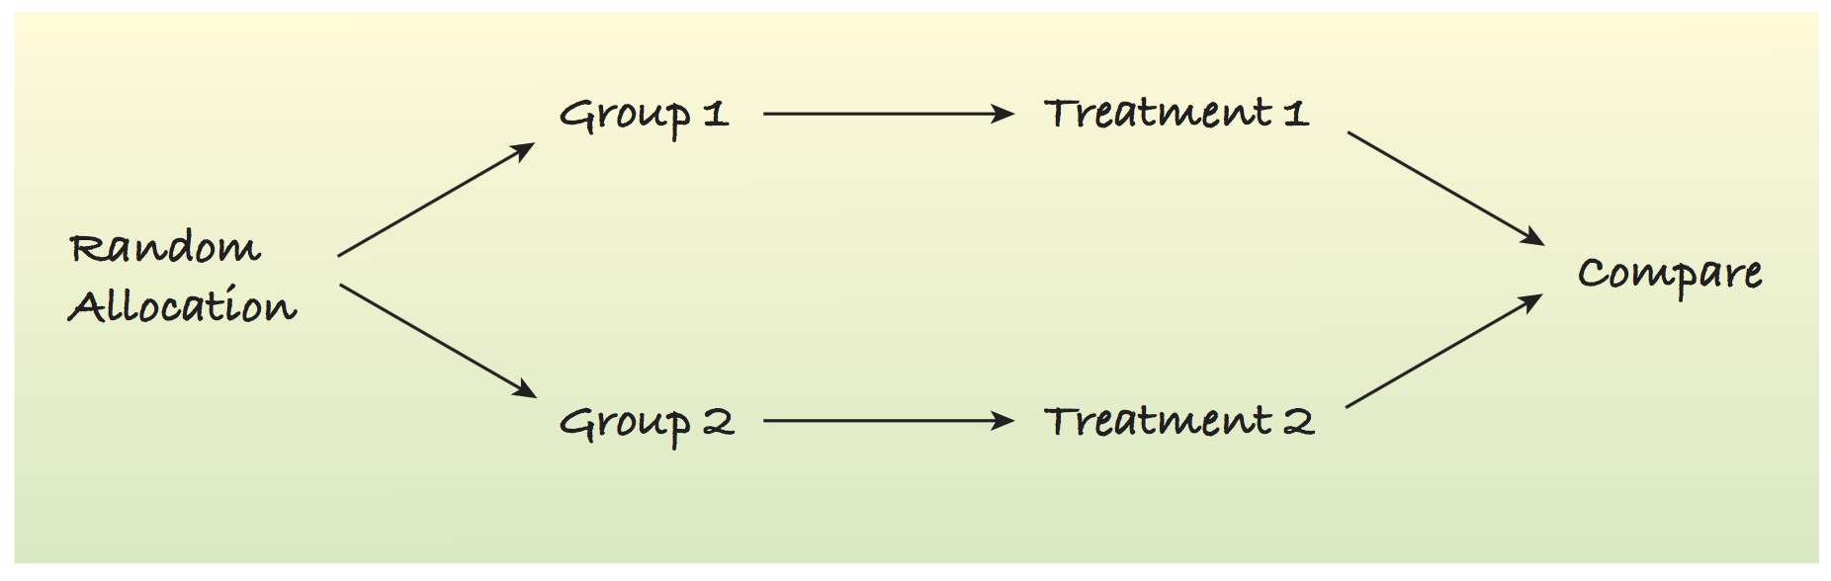
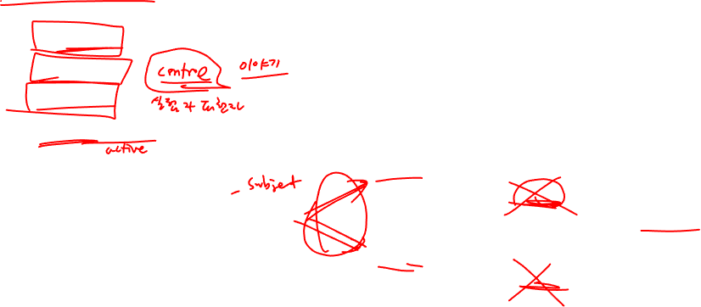

Lecture 09
Best experiments:
Randomized
Comparative
Double-blind
Placebo-controlled
Treatment
Double-blind
Placebo
CHOONG-WAN WOO | COCOAN lab | http://cocoanlab.github.io

Slide 17
Lecture 09
Quiz 09-2
https://forms.gle/e5J9ukUF3unwCpp38
CHOONG-WAN WOO | COCOAN lab | http://cocoanlab.github.io

Slide 18
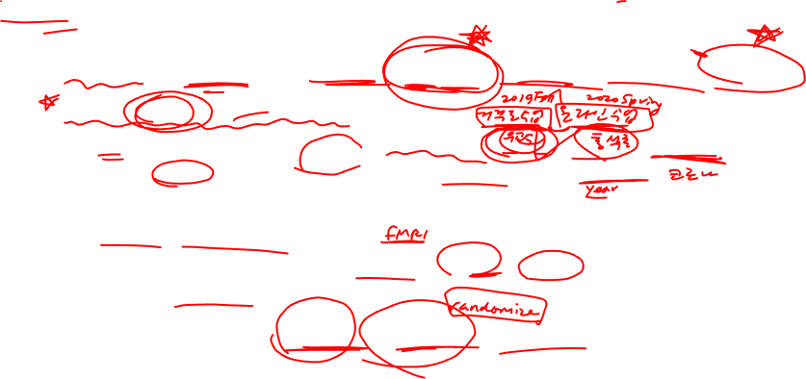
Lecture 09
Confounding
Two factors are confounded: when the levels of one factor are associated with the level of another factor.
No way to tease apart the two effects:
E.g., When examining the effects of different teaching styles, one class was during the fall semester, and the other class was spring. In this case, different teaching style was confounded with the season.
E.g., what if two different professors taught two different classes? Different teaching styles was confounded with professors and the seasons.
E.g., When examining the differences in brain signal for no pain and pain runs, and if no pain runs were always followed by pain runs, the pain manipulation was confounded with the order effects.
It’s super important to use the “control” and “randomize” strategies wisely.
CHOONG-WAN WOO | COCOAN lab | http://cocoanlab.github.io

Slide 19
Lecture 09
Quiz 09-3
https://forms.gle/4V42XfacZunqSFgz8
CHOONG-WAN WOO | COCOAN lab | http://cocoanlab.github.io

Slide 20
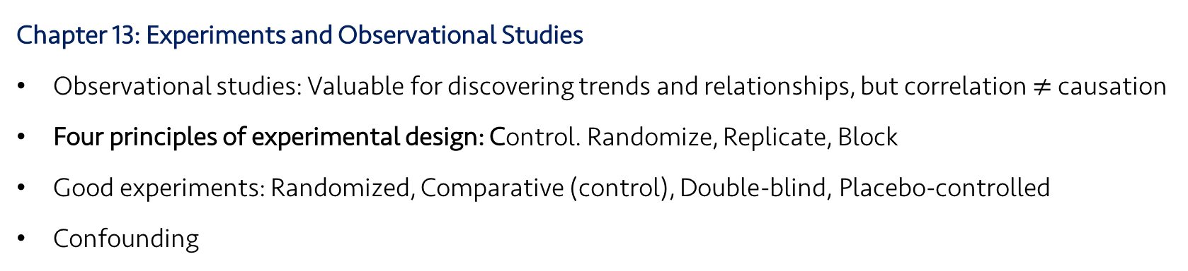
Lecture 09
Key Points
Chapter 13: Experiments and Observational Studies
Observational studies: Valuable for discovering trends and relationships, but correlation $≠$ causation
Four principles of experimental design: Control. Randomize, Replicate, Block
Good experiments: Randomized, Comparative (control), Double-blind, Placebo-controlled
Confounding
CHOONG-WAN WOO | COCOAN lab | http://cocoanlab.github.io

